Slide 1
Enquiry routines
May 2011
Notes:
© 2006 Capgemini - All rights reserved
0

Slide 2
Objectives
Enquiries
Enquiry Routines
Types of Enquiry Routines

Slide 3
Session Plan
Session 1
Enquiry Subsystem
Build Routines
Session 2
Workshops
Session 3
Conversion routines
Session 4
Workshops

Slide 4
Why Enquiry?
Fetch data from applications as required.
Data could be retrieved from single / multiple files
Data could be displayed in desired format.
Enquiries may be used to produce reports online, or from the end of day.
Notes:
Why Enquiry?
To fetch data from the T24 applications as required.
Data could be retrieved either from single file or multiple files.

Slide 5
Why Subroutines?
Programs Used to read/write data from/to T24 Files.
To perform any operation on the read data (without affecting the application)
Customize the data as required by the user
Could be Core or user defined
Notes:
Why Subroutines?
Programs which are generally used to read/write data from T24 Files.
Can be either core or user defined.

Slide 6
How to call Subroutines in Globus
We call subroutines in the following ways:
From Main line (Mark the TYPE as M in PGM.FILE entry)
Attached to a Utility. (Like Enquiry or Version)
From some other Program
Notes:
How do we call Subroutines in Globus?
From the main line by making an entry in PGM.FILE.
Or call be attached to a Utility for enhancement

Slide 7
Why Enquiry Routines:
To enhance Report by
Giving required Criteria before fetching data.
Make data suitable to display after fetching data (i.e)
Converting the data format as we require
Enhance the fetched data to suit the needs
Retrieving data from more than one file
Process the data based on user requirements
Notes:
Why Enquiry Routines:
To enhance Report by
Giving required Selection criteria before fetching the data.
Make suitable data available after fetching data
Retrieving data from more than one file

Slide 8
How does Enquiry Subsystem work:
Picks up the file name from the Enquiry
Refers Standard Selection Record
Applies Dynamic Selection and Satisfied IDs are build
Picks up the fields required
Displays the data

Slide 9
When do the enquiry routines called:
The enquiry routines are called
Either During Selection
Or Before Display

Slide 10
Working of Routines

Slide 11
Where do the common Variables Stored?
I_ENQUIRY.COMMON
Insert File containing common variables specific to enquiries
Similar to I_COMMON and I_EQUATE

Slide 12
What are the Variables used ?
O.DATA contains the last extracted value
R.RECORD
Defined in I_ENQUIRY.COMMON
Contains the record pertaining to the current ID
ENQ.ERROR contains the error text which stops the enquiry execution
D.FIELDS / D.LOGICAL.OPERANDS & D.RANGE.AND.VALUE contains the enquiry selection details
ID stores the current extracted record ID
Notes:
O.DATA contains the last extracted value
R.RECORD
Defined in I_ENQUIRY.COMMON
Contains the record pertaining to the current ID that has been extracted

Slide 13
Why Build Routine?
To manipulate “Selection Criteria Box”
Used Before fetching the ID

Slide 14
When Build Routine Invoked?
Invoked after fixed selection
Before the dynamic conditions gets executed
Notes:
Gets invoked after the fixed selection has been executed
Before the dynamic conditions specified in the Selection Criteria Box get executed

Slide 15
Where do we Attach Build Routine?
BuildRoutine.1 field of enquiry

Slide 16
How many parameters are passed to build routine?
One argument passed.
Dynamic Array. (Say ENQ.DATA)
Argument value resembles the structure of ‘selection criteria box’

Slide 17
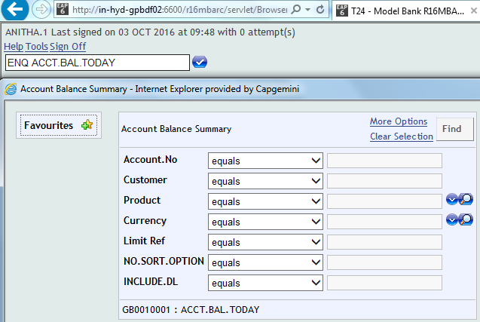
Structure
Value : enq.data<4>
Field Name : enq.data<2>
Operand : enq.data<3>
Enquiry Name : enq.data<1>

Slide 18
How to Write a Build Routine - Scenario
Create an enquiry that will display Customer Id, the Account Id and the respective working balance after accepting the category from the user.
For category 1001 - Balance should be in the range 0 and 49999
For category 6001 - Balance should be in the range 50000 and 100000
For categories greater than 7000 - Balance should be in the range 100000 and 500000

Slide 19
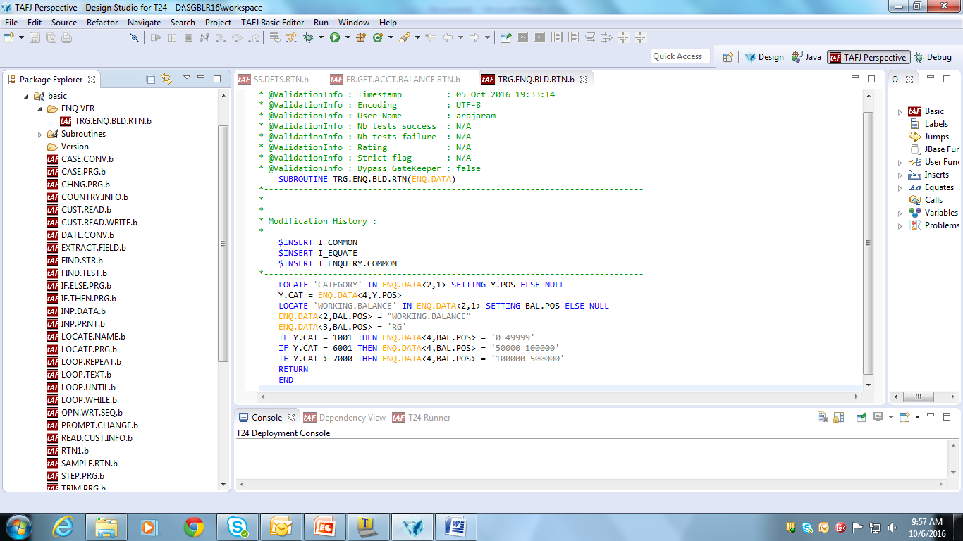
Write the Routine

Slide 20
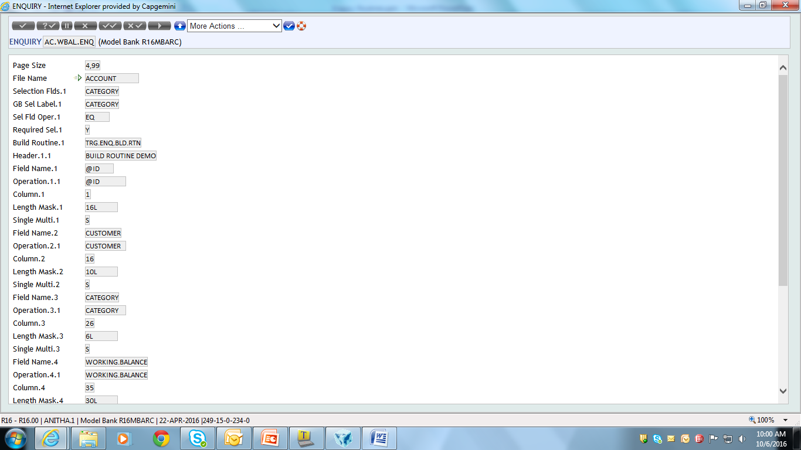
Create an Enquiry & Attach the routine to the enquiry

Slide 21
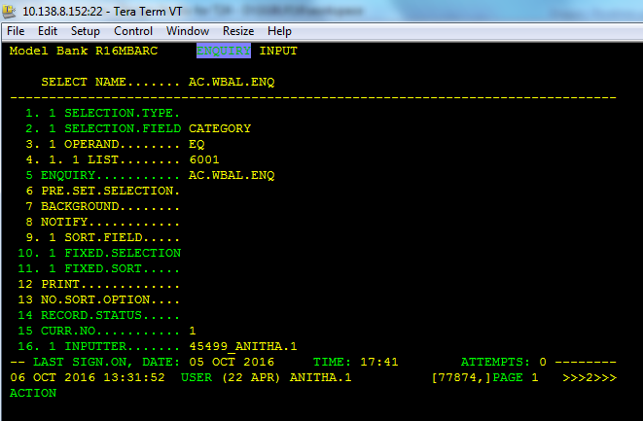
Run the Enquiry

Slide 22
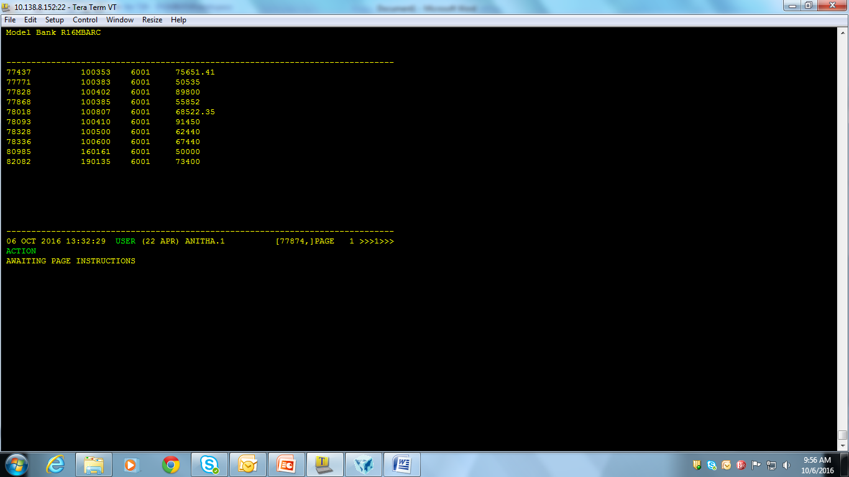
Run the Query

Slide 23
Workshop 1
Create an enquiry that will display the Debit Account Id and the respective Debit amount transferred after accepting the debit currency from the user.
For ‘USD’ the amount transferred is greater than 100
For ‘GBP’ the amount transferred is greater than 150
For currencies other than that amount transferred should be greater than 200

Slide 24
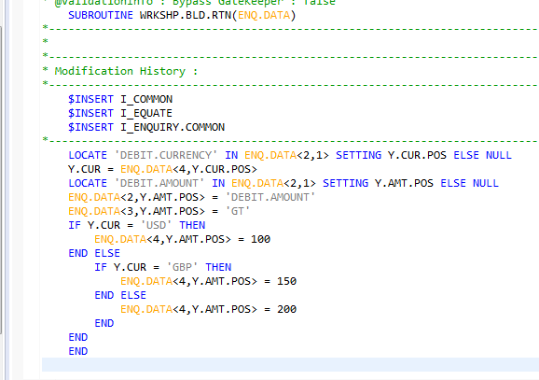
Write the Routine

Slide 25
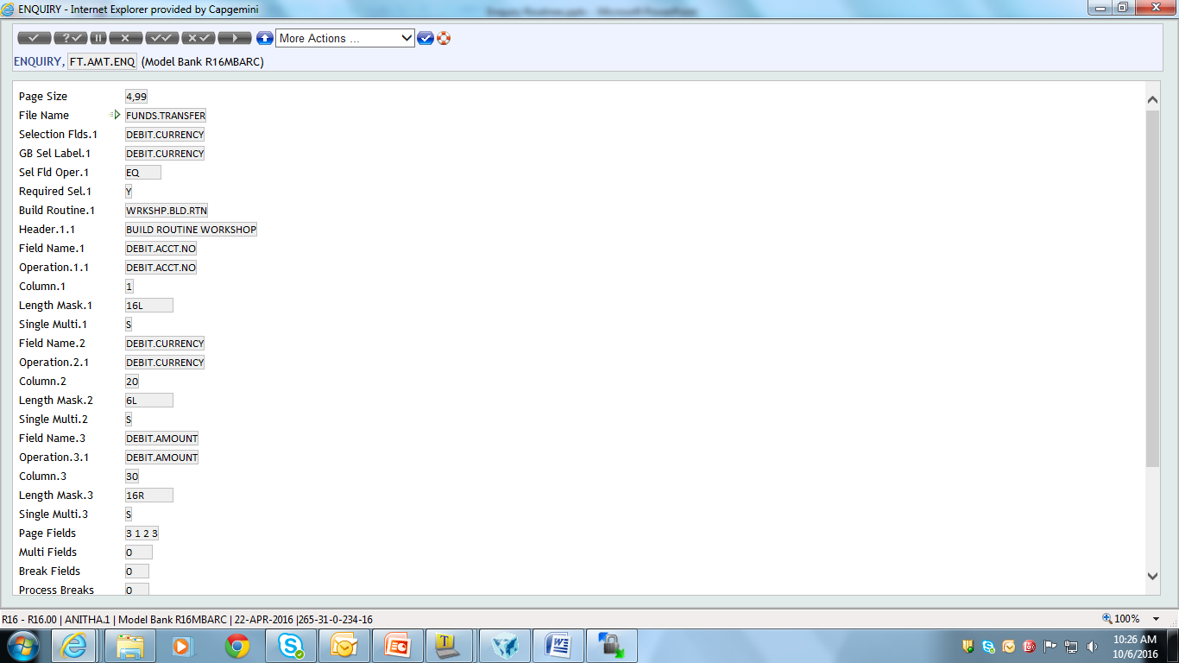
Create the Enquiry and attach the routine to the Enquiry

Slide 26
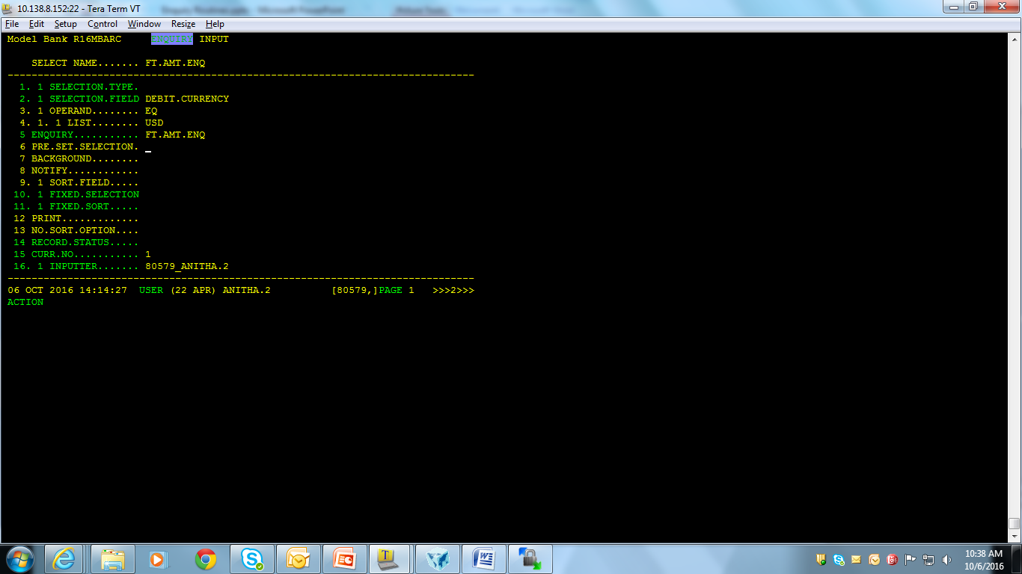
Run the Routine

Slide 27
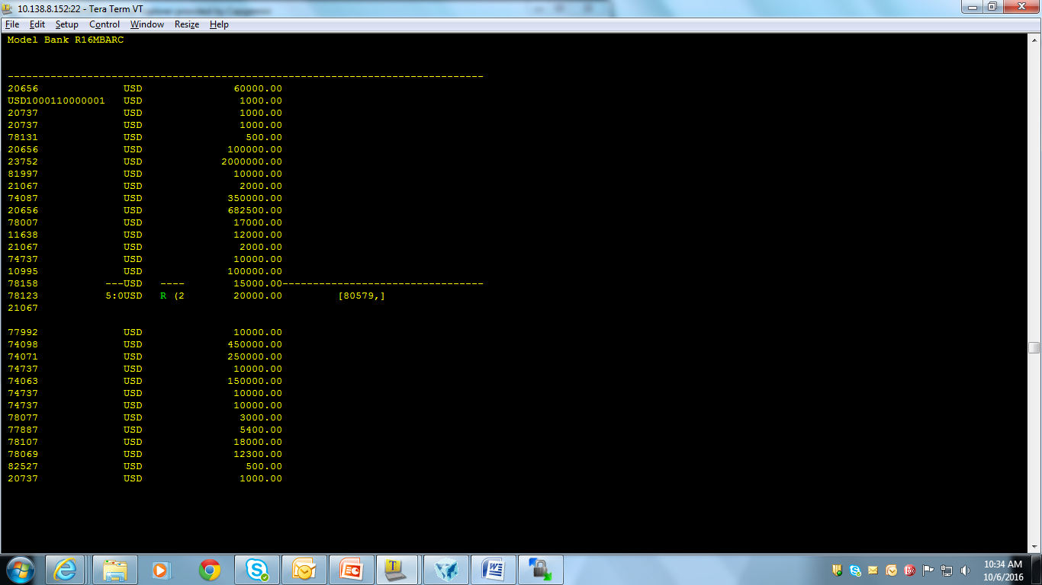
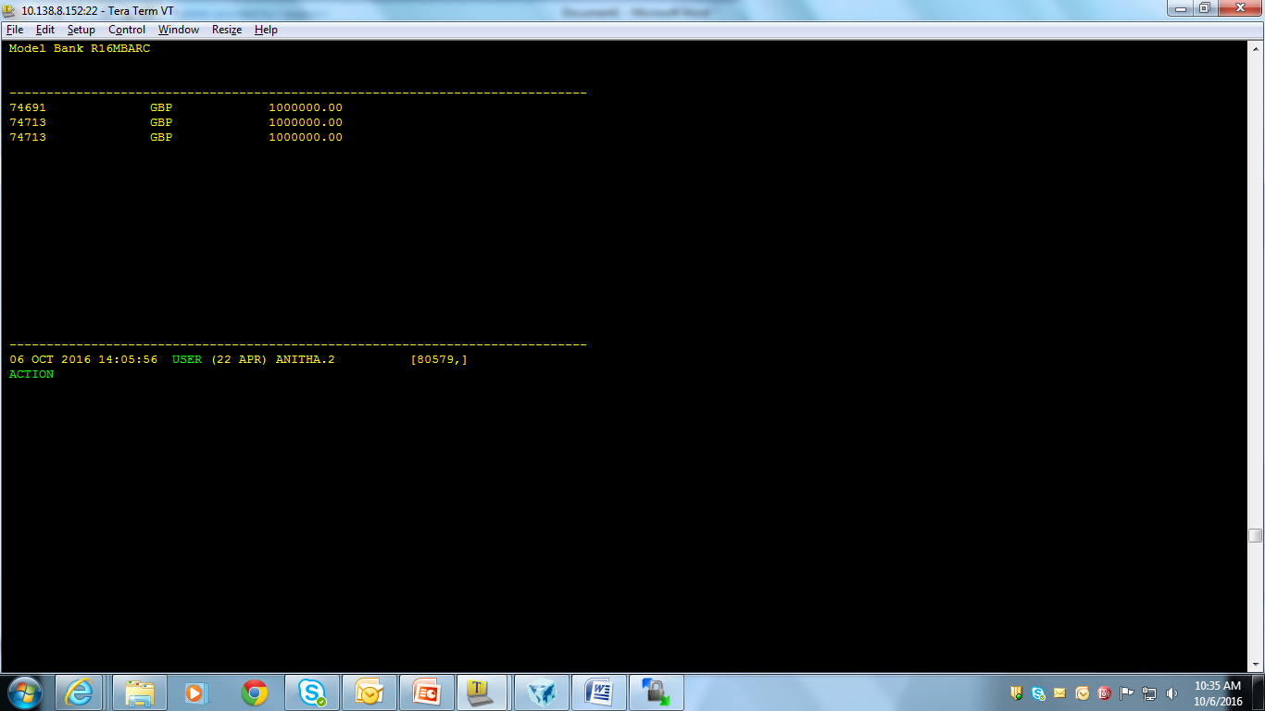
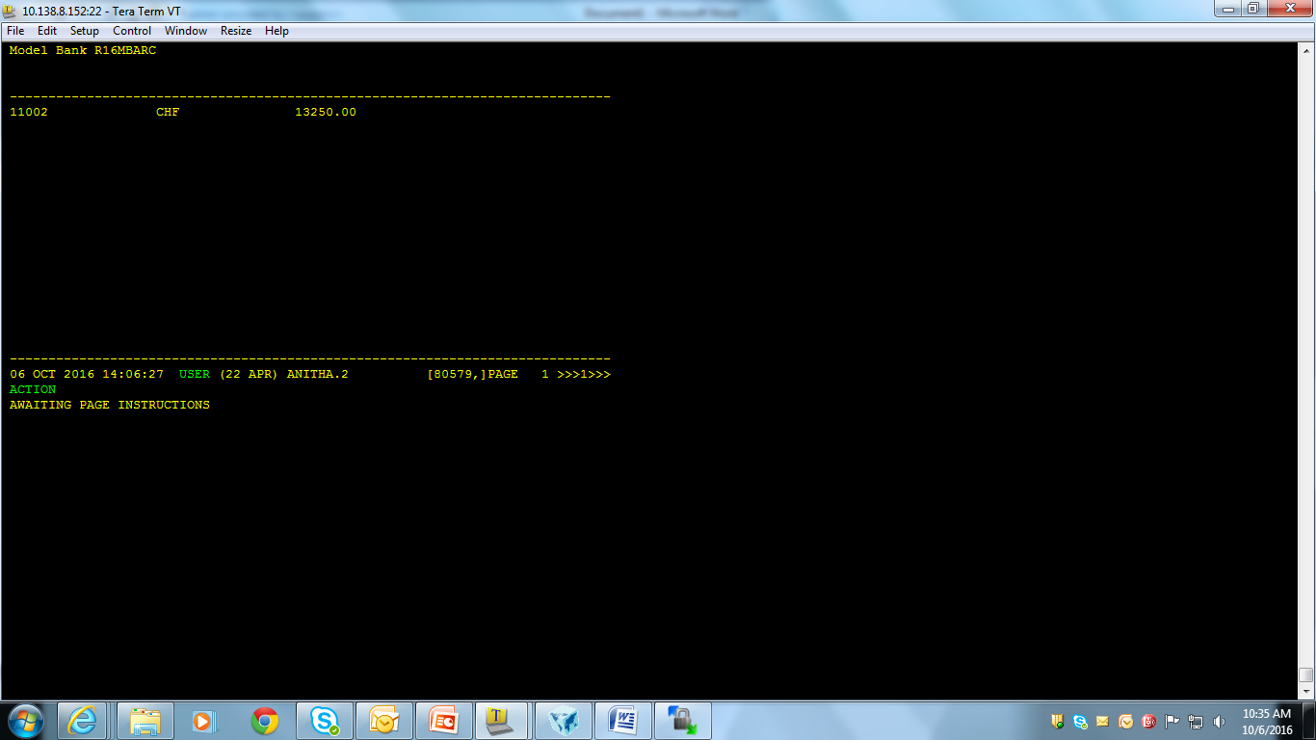
Run the routine

Slide 28
Why Conversion Routine?
Format data prior to display
Data available in O.DATA and R.RECORD enquiry common variables
Read another file and display value from it
Notes:
Gets invoked after fetching the required data
Before Displaying the data in the respective fields.

Slide 29
When Conversion Routine gets invoked?
Invoked after fetching required data
Before Displaying data in respective fields

Slide 30
Where do we attach Conversion Routine?
Attached to the conversion field
Prefixed with @ followed by space.
Notes:
Attached to the conversion field of the respective fields
Routine should be prefixed with @ followed by space.

Slide 31
How to write a Conversion Routine?
Create an enquiry that will list the Account Numbers, Customer Numbers and their respective Working Balances. In case the Currency of the Account is in foreign currency, they have to be converted to local currency and then displayed

Slide 32
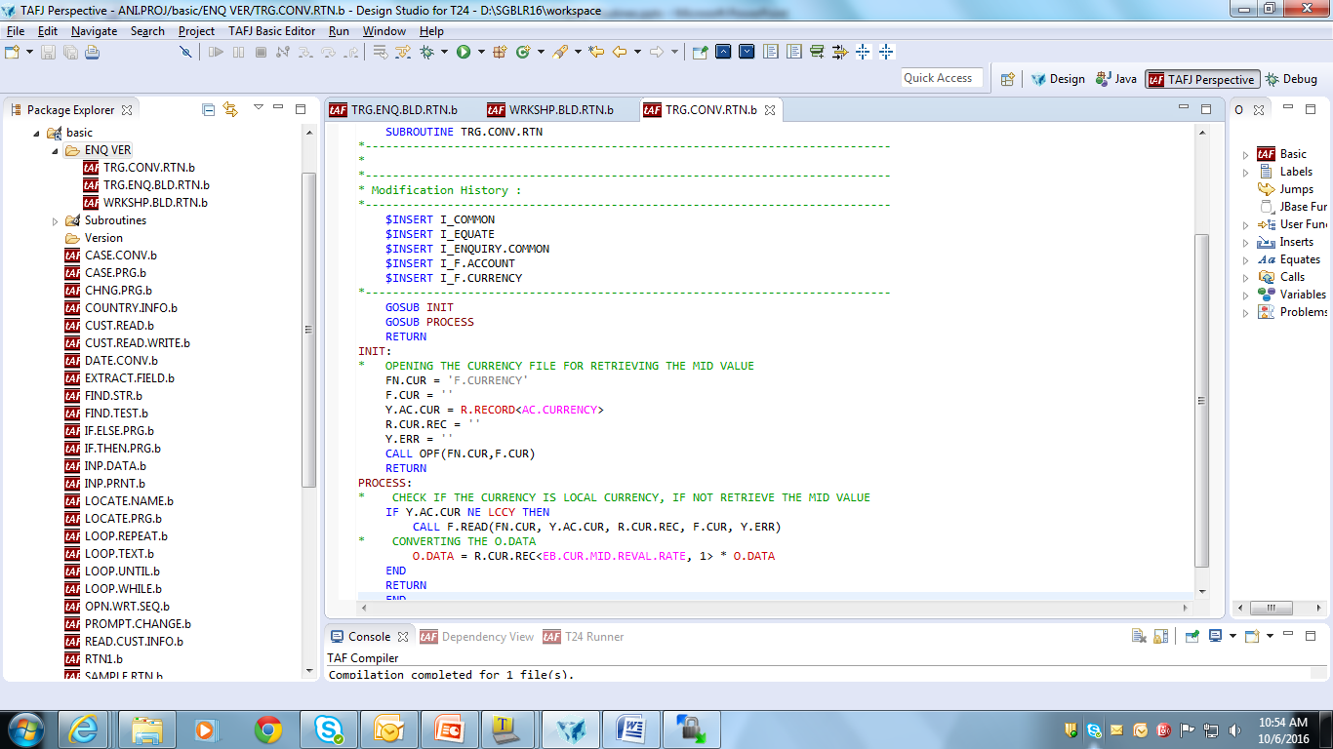
Solution

Slide 33
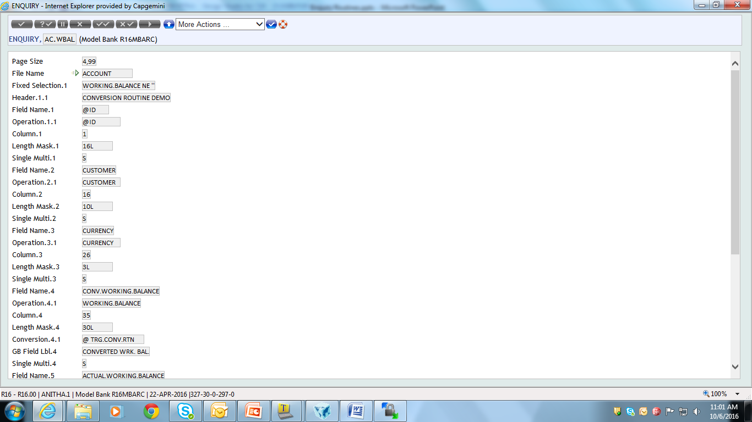
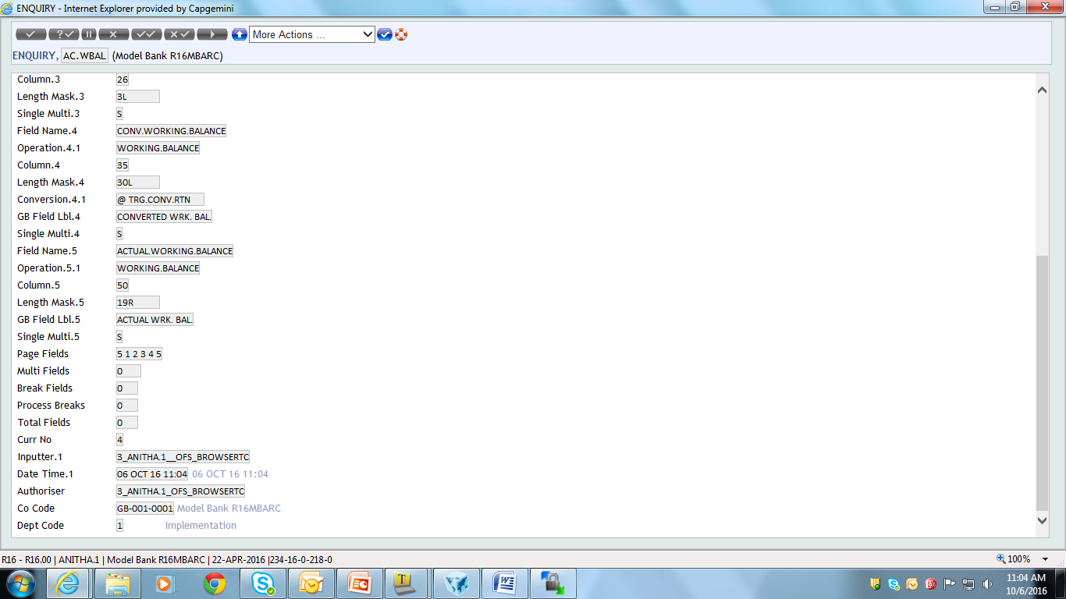
Create a Enquiry and attach the Routine to the Enquiry
Notes:
ACC.WB.ENQ

Slide 34
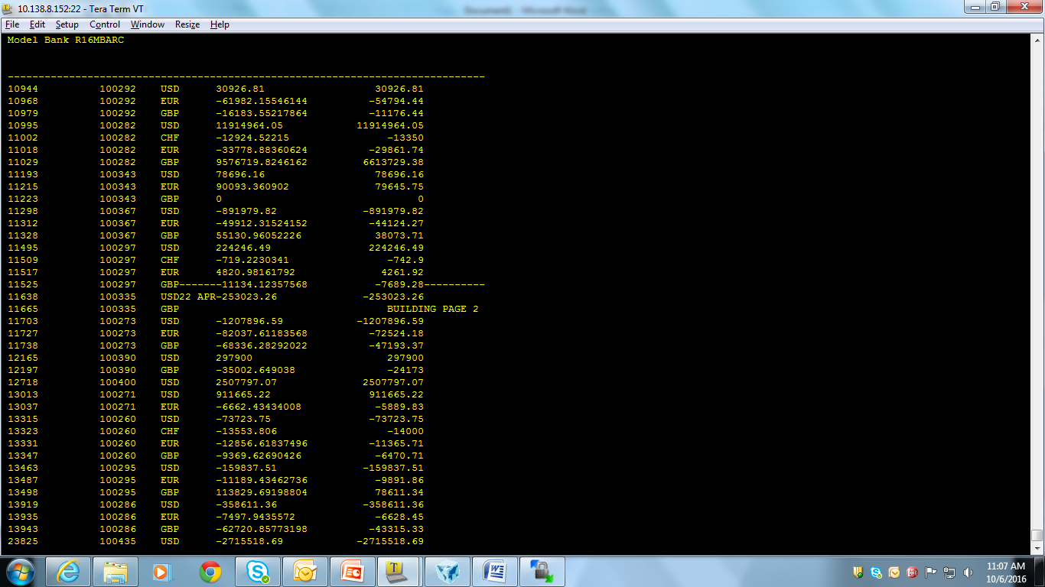
Run the Routine:

Slide 35
Workshop 2
Create an enquiry for account to display Account id, Category, Currency and Working balance. Write a conversion routine for the enquiry to display 'insufficient funds' if the amount is lesser than zero and 'critical funds' if the amount is less than 1000 otherwise sufficient balance.

Slide 36
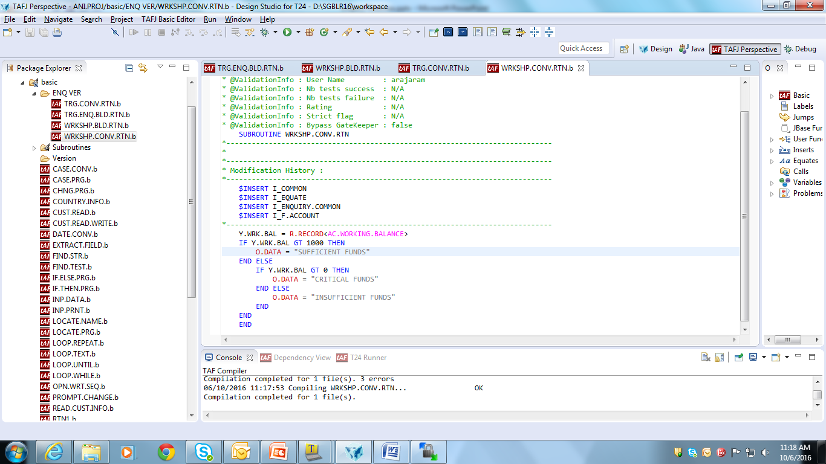
Solution

Slide 37
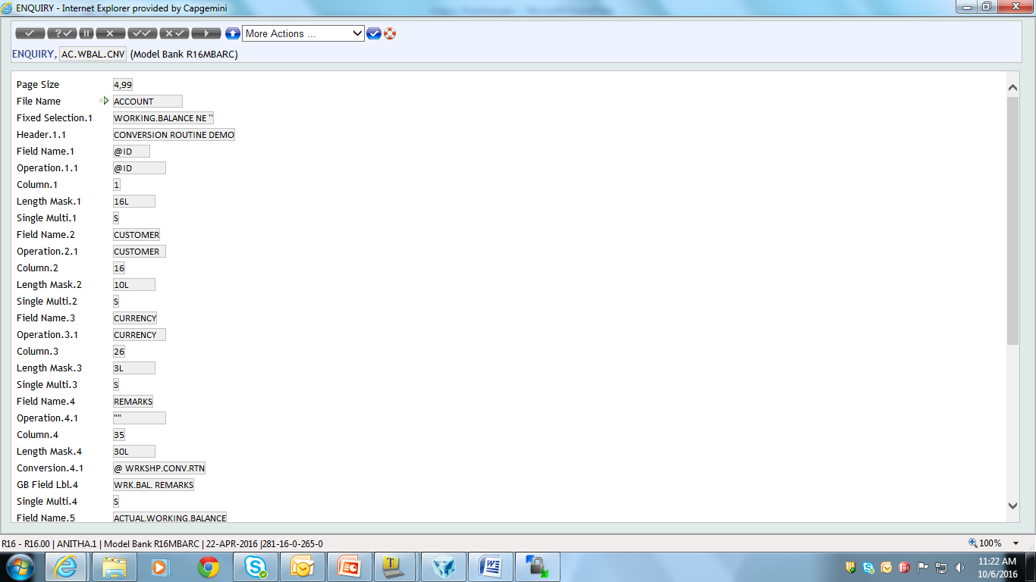
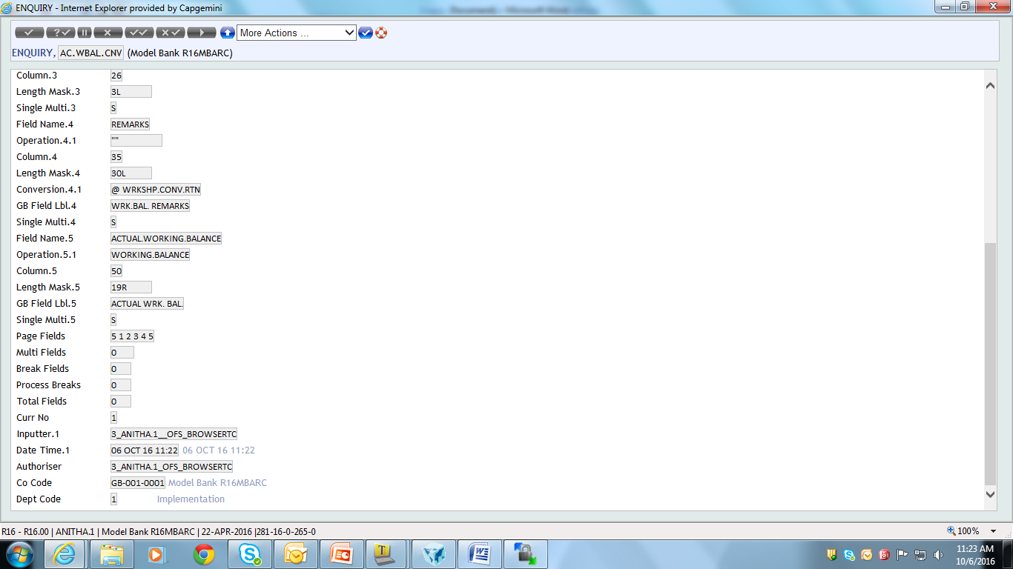
Create the Enquiry and attach the Subroutine to the conversion field

Slide 38
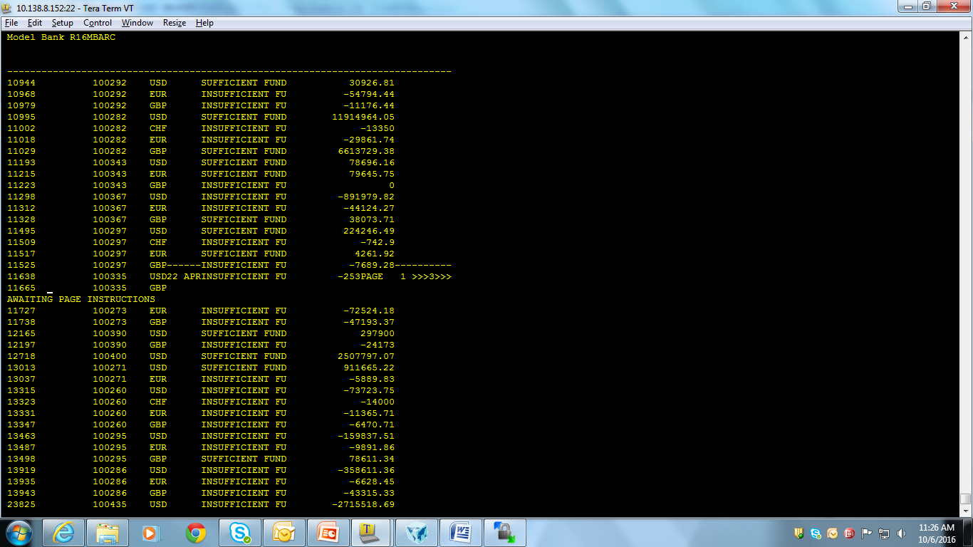
Run the Enquiry

Slide 39
Summary
We have learnt
Working of Enquiry Subsystem
To create Build Routines
To create Conversion Routines

Slide 40


www.capgemini.com/financialservices

